Slide 1
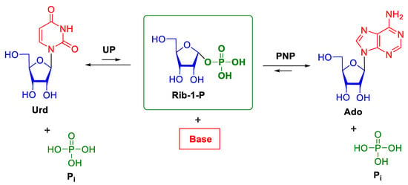
Transglycosylation reaction - scheme
Phosphorolysis of nucleosides catalyzed by nucleoside phosphorylases (NPs). Urd—uridine, UP—uridine phosphorylase, PNP—purine nucleoside phosphorylase, Rib-1-P—α-d-ribose-1-phosphate, Pi—inorganic phosphate ion
Nucleoside phosphorylases (NPs) become the most studied enzyme class with respect to nucleoside biosynthesis since the first member was isolated from rat liver.
NPs facilitate the reversible breakage/formation of a glycosidic bond between nucleobase and sugar moiety in the presence of inorganic phosphate. In vivo, the thermodynamic equilibrium directs the reaction towards nucleobase liberation while the opposite occurs in vitro.

Slide 2
Adaptive evolution as a tool for E. coli strain producing extracellular transglycosilases
The main target was to develop E. coli strains producing enzymes in a good quality, high volume and low price.
In addition, due to some problems with protein purification from the cell lysate we decided to develop strains producing recombining enzymes in a commercially applicable way. Such approach has not been published so far.
A lot of effort has been made to develop E. coli strains producing nucleoside phosphorylases and to scale up a biosynthetic process
Adaptive laboratory evolution (ALE) was used to screen and select positive colonies
Colonies with traces of high production were repeatably treated by mutagens, screened and selected until the satisfactory peroduction was reached.
Strains producing minimum 1 g UP or PNP/l media were selected for final optimization.

Slide 3
Product characteristics
Production of transglycosilases, both UP and PNP in a minimum quantity of 5 g/l media
Low production cost
Known gene sequence and AA sequence of both enzymes
Defined vector
Stable production
UP or PNP forming minimum 85% of all proteins
Simple and cheap purification by combining heat and ammonium sulfate precipitation (due to the presence of his tag IMAC can be explored if needed)
Ammonium sulfate precipitate can be used directly for biosynthesis
No need to protect enzyme from degradation during the synthesis
Availability of recombinant UP and PNP is for us no more limitation of the biosynthetic process of nucleosides

Slide 4
Examples of Enzymes application I – Biosynthesis of Cladribine
Cladribine (2-chloro-2′-deoxy-β-D-adenosine) is an FDA approved drug for the treatment of hairy cell leukemia. It received both EMA and FDA approvals for relapsing–remitting multiple sclerosis (RRMS) treatment. Due to this new indication the inovator expects sales over 1 bil USD in 2025, which makes cladribine the compound of growing interest.
Traditionally, cladribine is synthesized by a chemical synthesis that requires multiple reaction steps processed in multiple equipment, the use of organic solvents, and removal of protecting groups, causing the accumulation of racemic mixtures that affect further purification.
Our biosynthetic process is quite efficient, characterized by production of about 5 g cladribine/l media/ 1 hr. The process is completely organic solvent free, purification is realized by a combination of crystallization/recrystallization, no need of chromatographic purification to reach USP or EP specifications.
Conversion of intermediates is over 85%, total yield is about 60% with a purity closed to 99.9%.
The process does not need any special equipment to produce cladribine, it is a simple one step biosynthesis in buffered water medium, highly reproducible, easy to validate
Patent application PV 2023-33 to protect cladribine enzymatic synthesis has been submitted and reviewed by the Czech Patent Office recently

Slide 5
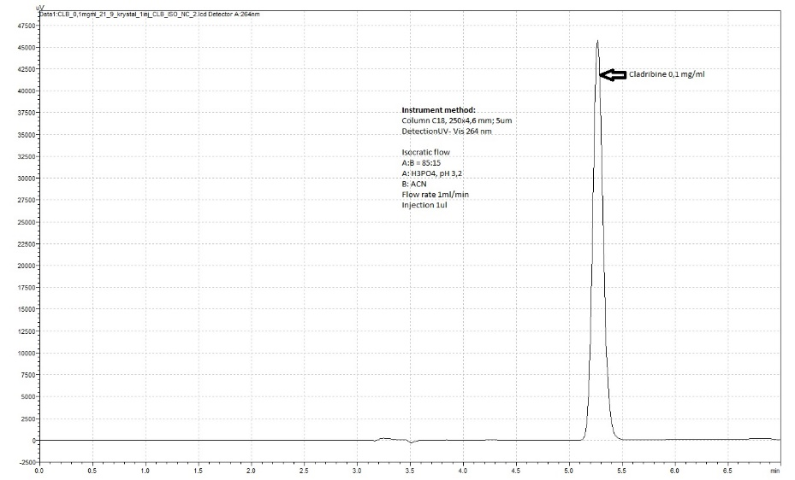
HPLC profile of recrystalized cladribine

Slide 6
Available final dosage forms
Solid dosage forms:
Hydroxypropyl-β-cyclodextrin – clone to the current Mavenclad (freeze-drying replaced by solid dispersion)
Polysaccharide based solid dispersion
Oral liquid dosage form:
Microemulsion preconcentrate in soft gelatin capsules
Liquid dosage forms:
Subcutaneous formulation 7-10mg/ml
Eye drops – under development

Slide 7
Example of Enzymes application II – biosynthesis of cordycepin
Although different chemical synthesis methods of COR have developed, many problems still existed, including: a complicated synthesis process, cumbersome purification process, harmful organic solvents used in the synthesis process, and high cost.
Therefore, chemical synthesis of COR is not suitable for large-scale industrial production at present. Some defects are unavoidable and the production is still far from the demand of cordycepin.
Our biosynthetic process is quite efficient, characterized by production of about 6 g cordycepin/l media/ 1 hr.
The process is completely organic solvent free, including purification process, conversion of intermediates is over 85 %, total yield is about 60 % with a purity up to 99.00 %.
Both chlorinated and fluorinated cordycepin analogues (potentially resistant to deamination by Adenosine deaminase) can be prepared in a large scale, as well
Patent application PV 2022-545 to protect cordycepin enzymatic synthesis has been submitted and reviewed by the Czech Patent Office recently

Slide 8
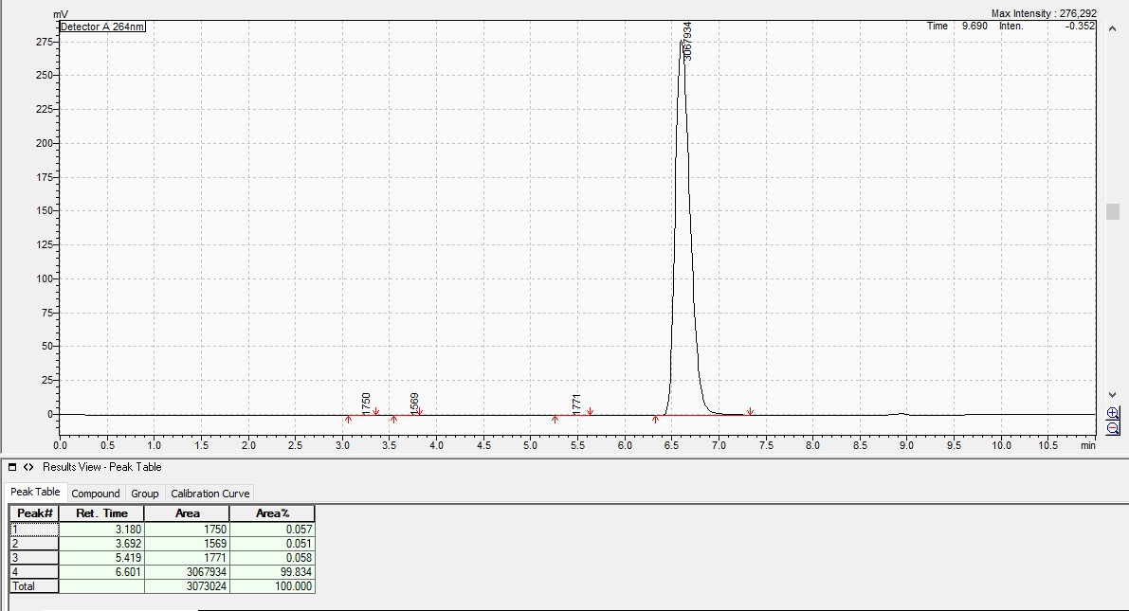
HPLC profile of cordycepin

Slide 9
Summary
We have in house conveniet source of recombinant enzymes which allows us to develop green, enzyme-based biosynthesis of nucleoside and their analogues
Our enzyme-based synthesis is flexible, completely organic solvent- free and fulfils definition of a green process
Simpled equipmentrequired, one-pot reaction
HPLC – free final product purification
Two recombinant transglycosilases are availabe right now
Several new enzymes are in a pipe line including e.g. Adenosine deaminase, Asparaginase II, Alcaline phosphatase, etc.
At present, beside the enzymes we can offer also vertically integrated process of cladribine production – our nearest future goal is to provide integrated approach to any produced nucleosides

